Slide 1
Chapter 6
An Introduction to System Software and Virtual Machines

Slide 2
Learning Objectives
Compare the virtual machine created for the user by system software with the naked machine
Describe the different types of system software
Explain the benefits of writing programs in assembly language rather than machine language
Describe how an assembler translates assembly language programs into machine instructions
List five key tasks of an operating system, and explain what each is and why it is critical to modern systems
Describe the different generations of operating systems, their features, and how each generation solved a drawback of the previous generation

Slide 3
Introduction
A naked machine has no tools or programs to help the user:
Write instructions in binary
Write data in binary
Load instructions into memory one cell at a time
Initiate program run
Quickly became too difficult for humans to do
An interface had to be developed to hide the details and make the computer easier to build

Slide 4
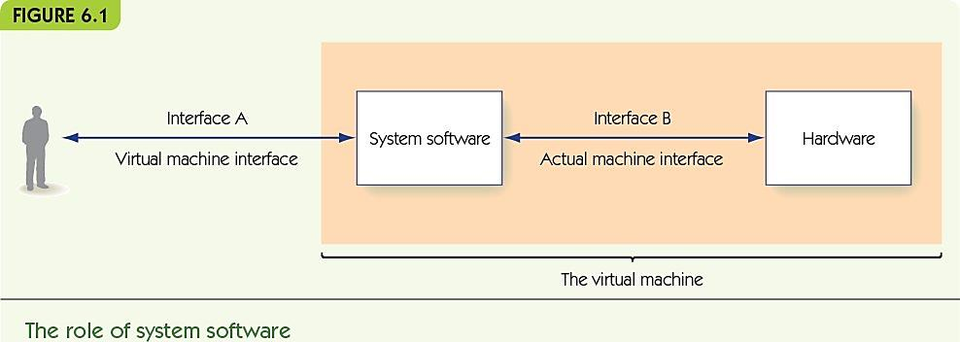
System Software (1 of 7)
System software is a collection of programs to:
Manage resources of the computer
Serve as intermediary between user and hardware
System software creates a virtual machine (or a virtual environment) that the user sees

Slide 5
System Software (2 of 7)
Operating system
single most important piece of software on the computer made up of:
The user interface
Memory managers
I/O systems
Utilities
Language services
Information managers
Scheduler

Slide 6
System Software (3 of 7)
Communicates with users, determines what they want, and activates other system programs, applications, packages, or user programs

Slide 7
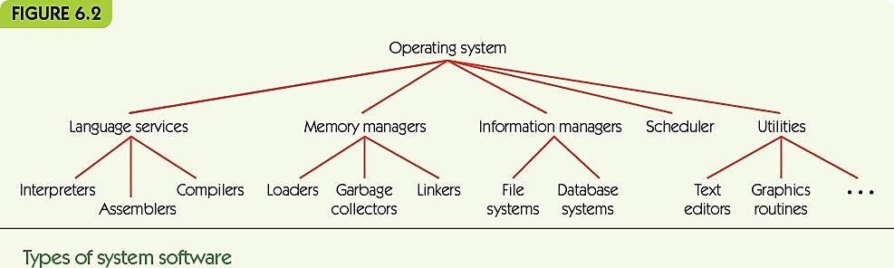
System Software (4 of 7)
Language services support high level languages
Memory managers allocate memory to programs
Information managers organize mass storage
Scheduler manages programs waiting to run
Utilities: tools, including program libraries

Slide 8
System Software (5 of 7)
Graphical user interface (GUI): Pronounced “gooey”
Visual interface to the virtual machine including:
Operating system and system programs
User programs
I/O systems communicate with various devices such as:
Printers
Scanners
Keyboards
Mice

Slide 9
System Software (6 of 7)
Naked machine
Write program in binary
Load instructions one by one into memory
Insert start into memory address 0 and push “go” button
Read results from memory one by one, in binary

Slide 10
System Software (7 of 7)
Virtual machine
Write program using text editor in high-level language
Save program to folder
Use translator to convert to binary
Use scheduler to load and run
Use I/O system to print results

Slide 11
Assemblers and Assembly Language (1 of 20)
Low-level programming language is also called assembly language:
Instructions map one-to-one to machine language
Symbolic op codes (not binary)
Symbolic addresses for instructions and data
Pseudo-ops for data generation and more (data in human-friendly terms)
Advantages over machine code
Clarity, readability, and maintainability
Can be placed at different locations in memory

Slide 12
Assemblers and Assembly Language (2 of 20)
High-level programming languages:
Java, C++, and Python
Advantages over assembly language:
More powerful
One high-level instruction may provide multiple machine instructions
User oriented
Not machine specific
Use both natural language and mathematical notation

Slide 13
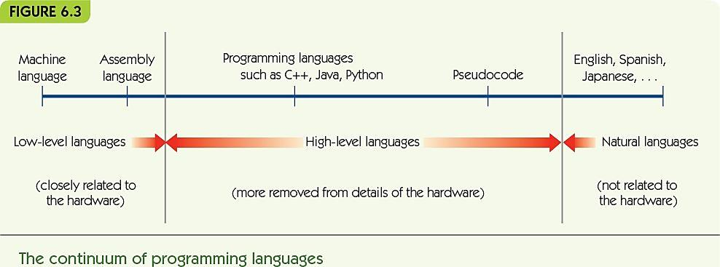
Assemblers and Assembly Language (3 of 20)

Slide 14
Assemblers and Assembly Language (4 of 20)
Assembly language process:
Source program (assembly language)
Translated by the assembler to
Object program (machine language)
Loader places in memory
Hardware runs
Results

Slide 15
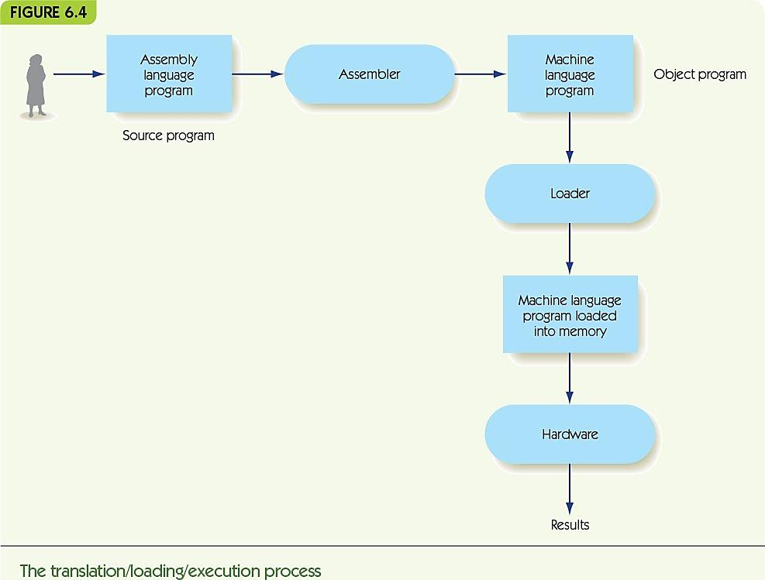
Assemblers and Assembly Language (5 of 20)

Slide 16
Assemblers and Assembly Language (6 of 20)
Example assembly language:
NEXTSTEP: LOAD X -- Put X into reg. R
label: opcode mnemonic address field -- comment
Label is optional name for this instruction’s location
Op code mnemonic and address field translate to machine language
Comments are ignored by assembler—just for human use

Slide 17
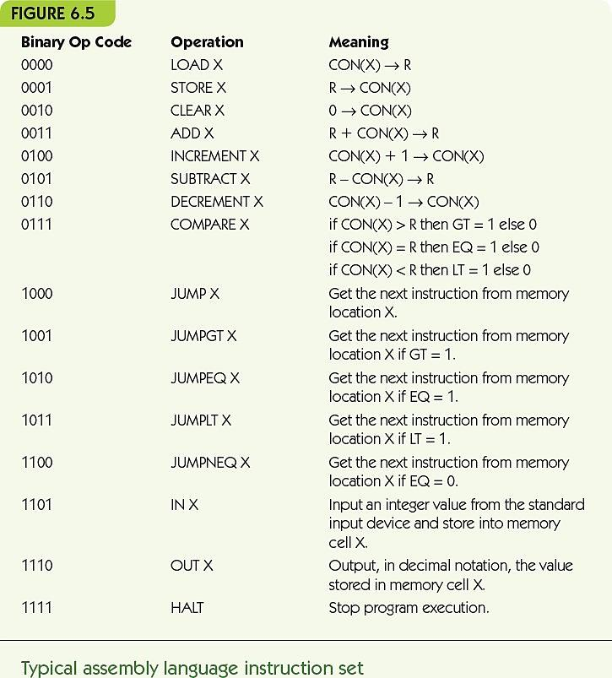
Assemblers and Assembly Language (7 of 20)

Slide 18
Assemblers and Assembly Language (8 of 20)
Pseudo-op: commands in the program directed to the assembler, not converted to machine instructions:
.BEGIN and .END to mark where instructions are
.DATA to mark memory location as holding data:
COUNTER: .DATA 0
X: .DATA 12

Slide 19
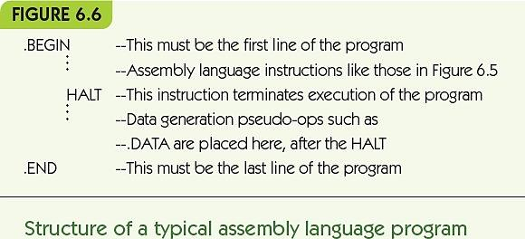
Assemblers and Assembly Language (9 of 20)

Slide 20
Assemblers and Assembly Language (10 of 20)
Simple examples:
x = y + 3
input a and b
while a > b do
print a
a = a – 2
LOAD Y
ADD THREE
STORE X
… -- Data comes after .END
X: .DATA 0 -- X is initially 0
Y: .DATA 5 – Y is initially 5
THREE: .DATA 3 –The constant 3
IN A
IN B
LOOP1: LOAD A A: .DATA 0
COMPARE B B: .DATA 0
JUMPLT LOOP1END TWO: .DATA 2
JUMPEQ LOOP1END
OUT A
LOAD A
SUBTRACT TWO
STORE A
JUMP LOOP1
LOOP1END: …

Slide 21
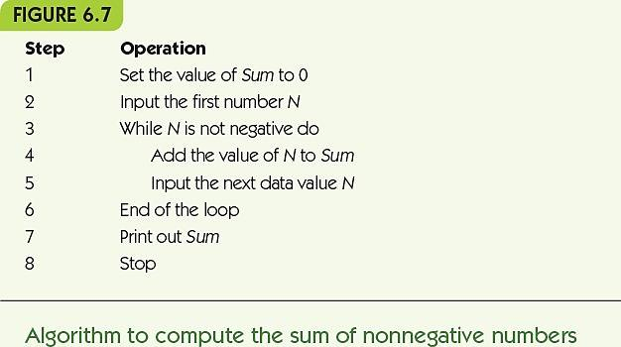
Assemblers and Assembly Language (11 of 20)

Slide 22
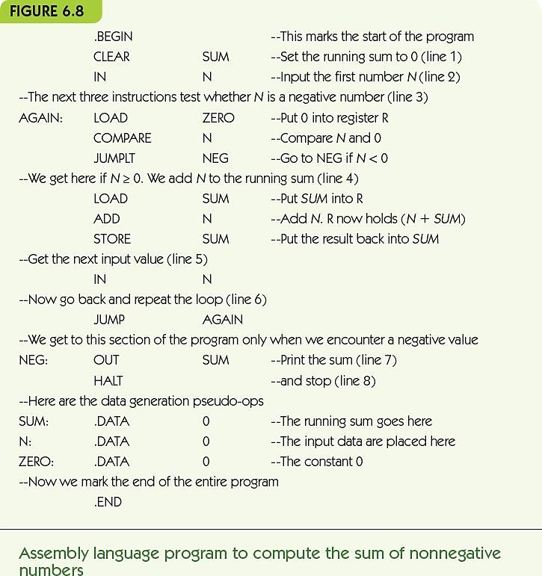
Assemblers and Assembly Language (12 of 20)

Slide 23
Assemblers and Assembly Language (13 of 20)
Translation and Loading
Assembler translates to machine language:
Converts symbolic op codes to binary equivalents
Converts symbolic labels to memory addresses
Performs pseudo-op actions
Writes object file containing machine instructions
Loader gets program ready to run:
Places instructions in memory
Triggers the hardware to run the program

Slide 24
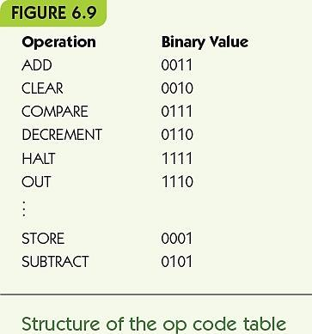
Assemblers and Assembly Language (14 of 20)
Converting symbolic op codes to binary ones
Assembler maintains a table
Assembler looks up symbolic op codes in the table and substitutes the binary analogue
Use binary search to optimize table lookups

Slide 25
Assemblers and Assembly Language (15 of 20)
Converting symbolic labels to memory addresses
Assembler needs two passes
Looks over assembly code two times
First pass:
Keeps a count of how many instructions from the start
Collects symbolic labels and add to symbol table along with location counter

Slide 26
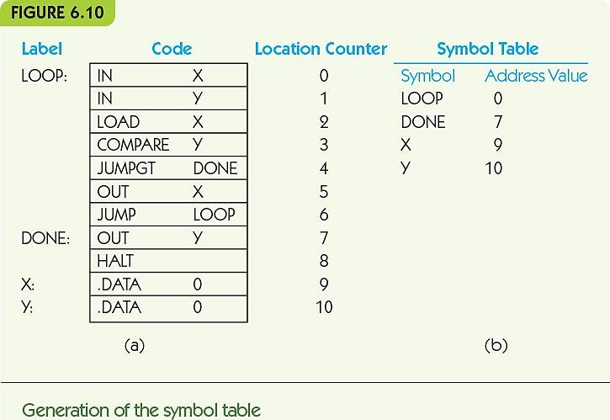
Assemblers and Assembly Language (16 of 20)

Slide 27
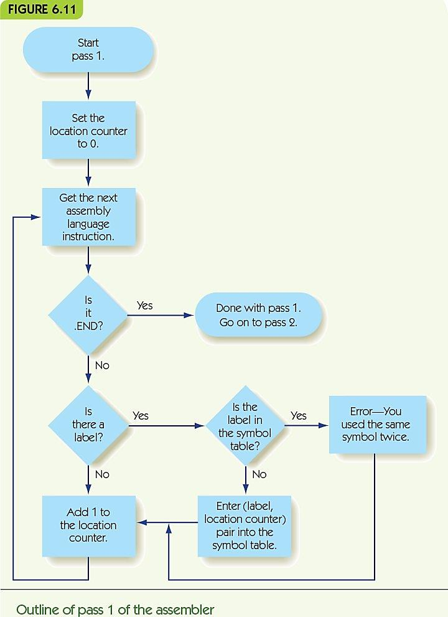
Assemblers and Assembly Language (17 of 20)

Slide 28
Assemblers and Assembly Language (18 of 20)
Second pass:
Looks up and replace op codes
Substitutes label references with location from symbol table
Sets up .DATA pseudo-ops with location and binary value
Writes instructions to object file

Slide 29
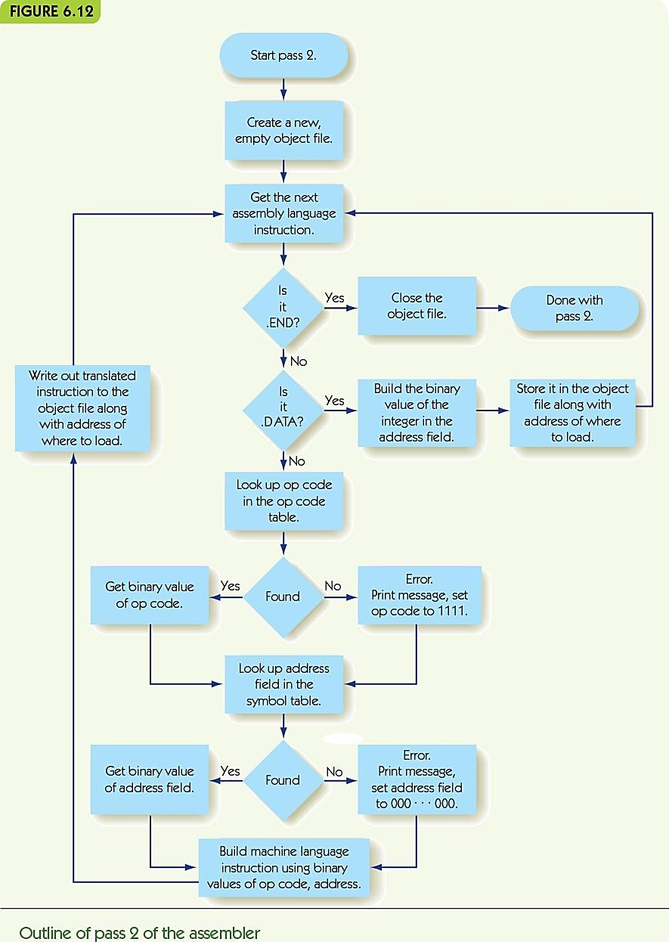
Assemblers and Assembly Language (19 of 20)

Slide 30
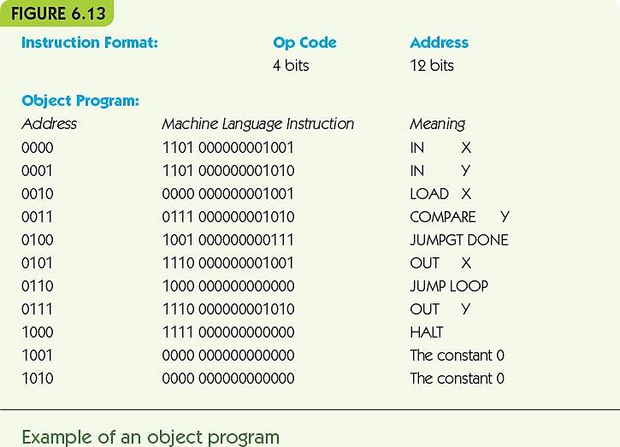
Assemblers and Assembly Language (20 of 20)

Slide 31
Operating Systems (1 of 21)
System commands: user instructions about what the computer should do
Some typical operating system commands
Load a program
Run a program
Save information in a file or a directory
Retrieve a file previously stored
List all the files for this user
Delete or rename a file
Print a file on a specified I/O device

Slide 32
Operating Systems (2 of 21)
Copy a file from one I/O device to another
Establish a network connection
Let the user set or change a password
Tell how much memory or data storage is being used

Slide 33
Operating Systems (3 of 21)
Functions of an Operating System
User interface: user communicates with operating system
Operating system as receptionist and dispatcher
User command → system software scheduled and run → repeat
Text-based
System commands typed at a prompt in a terminal
Command language must be learned
GUI-based
System commands by a visual/mouse interface

Slide 34
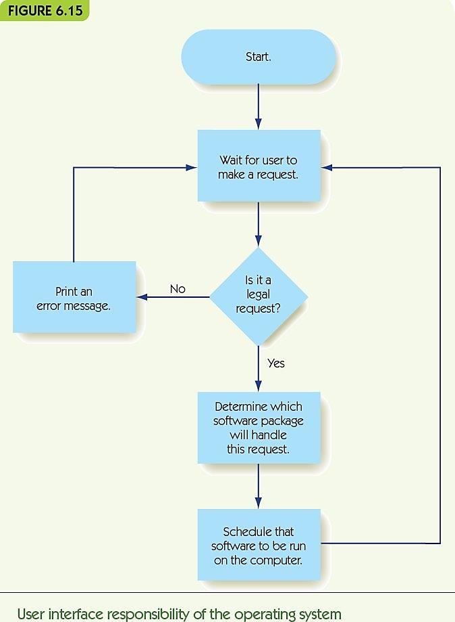
Operating Systems (4 of 21)

Slide 35
Operating Systems (5 of 21)
System security and protection: permit only authorized access to resources
Operating system as a security guard
Access protected by usernames and passwords:
Superusers have more privileges
Encrypt data to increase security
Folders and files have authorization lists:
Read a file, add new information to a file, change existing information, and delete a file

Slide 36
Operating Systems (6 of 21)
Access control list for the file GRADES
File: GRADES
Name | Permitted Operations
Smith | R(R=Read Only)
Jones | RA(A=Append)
Adams | RAC(C=Change)
Doe | RACD(D=Delete)

Slide 37
Operating Systems (7 of 21)
User interface management (receptionist)
Control of access to system and data files (security guard)
Program scheduling activation (dispatcher)
Efficient resource allocation (efficiency expert)
Deadlock and error detection (traffic officer)

Slide 38
Operating Systems (8 of 21)
Example of sharing CPU:
Waiting Ready Running
B A
C
A makes I/O request:
Waiting Ready Running
A C B
A finishes with I/O:
Waiting Ready Running
C B
A

Slide 39
Operating Systems (9 of 21)
A deadlock occurs when multiple programs are requesting the resources that each one is currently using
Safe use of resources: ensure that the computer doesn’t get stuck in deadlock
Deadlock prevention: if you can’t get all resources, release all you have and try again later
Deadlock recovery: if no acknowledgement, send message again

Slide 40
Operating Systems (10 of 21)
Historical development of operating systems:
First generation: nearly “naked computer”:
Programmer hand-loaded programs
Second generation: batch operating systems:
Programmers gave programs to operators
Operators collected a “batch” of programs
Used I/O computer to translate programs to tape
Ran programs as a group
Used I/O computer to translate output to text/paper
Job control language: instructions to OS

Slide 41
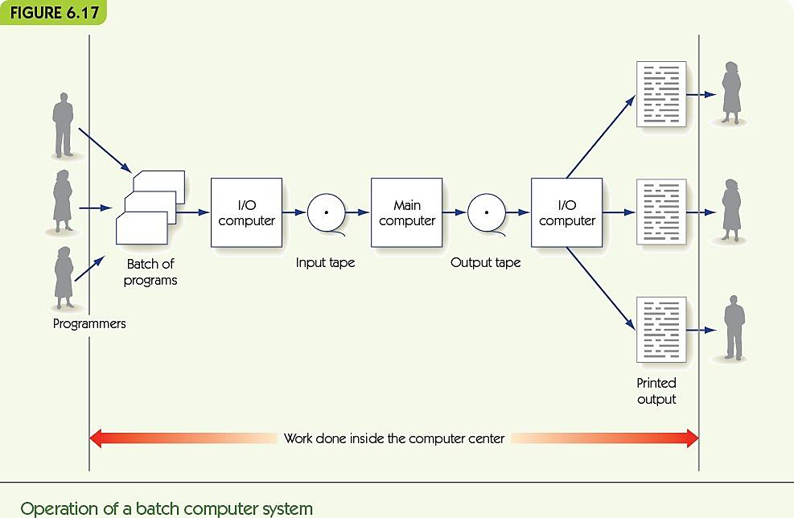
Operating Systems (11 of 21)

Slide 42
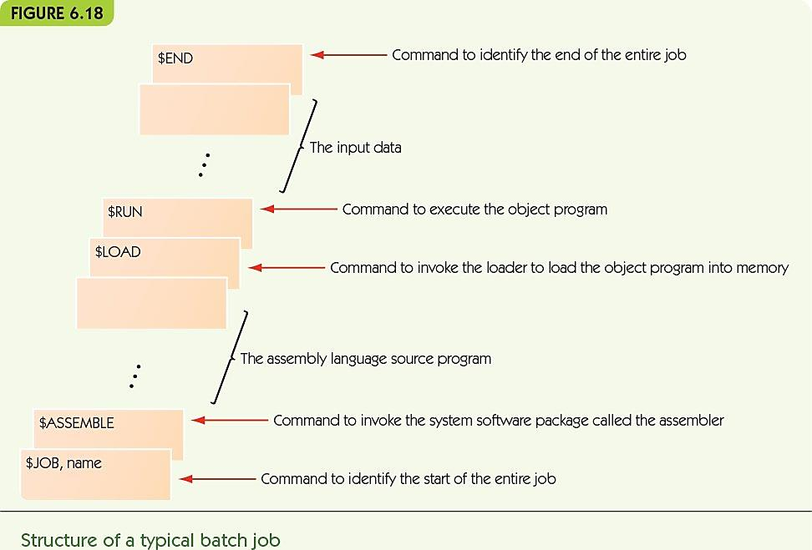
Operating Systems (12 of 21)

Slide 43
Operating Systems (13 of 21)
Third generation: multiprogrammed operating systems:
Multiple programs loaded at once
Switch between programs when I/O happens
Computer security now required!
Privileged operations only available to the administrator
Bound memory a program can legitimately access

Slide 44
Operating Systems (14 of 21)
Time-sharing system (also third generation):
Multiprogrammed, but users are on the system interactively
Users need an illusion of sole access
Allocate run time in time slices—each program runs until I/O OR time runs out

Slide 45
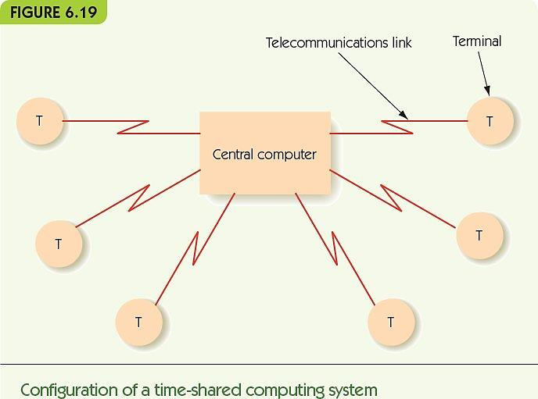
Operating Systems (15 of 21)

Slide 46
Operating Systems (16 of 21)
Fourth generation: network operating system:
Operating system supports all the same local services
Also supports services that access resources that are available over a network:
Shared printer
Servers: email, data, web
Connections to the Internet
Real-time operating systems or embedded systems are special-purpose computers in other equipment

Slide 47
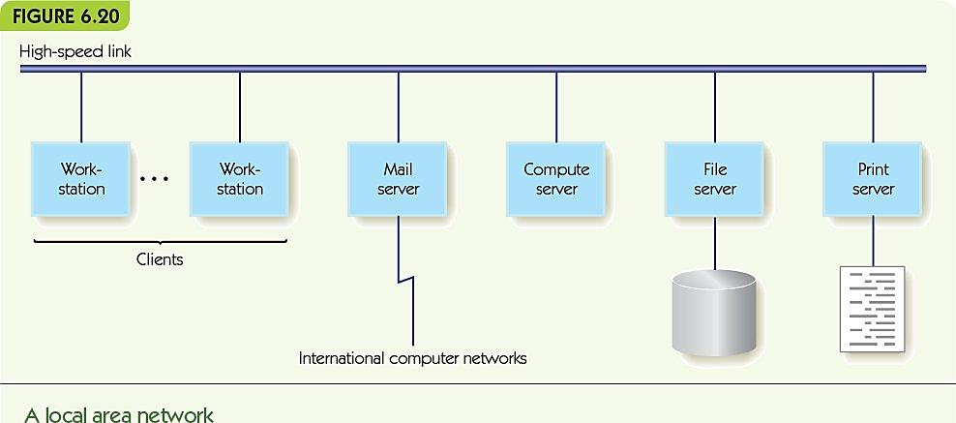
Operating Systems (17 of 21)

Slide 48
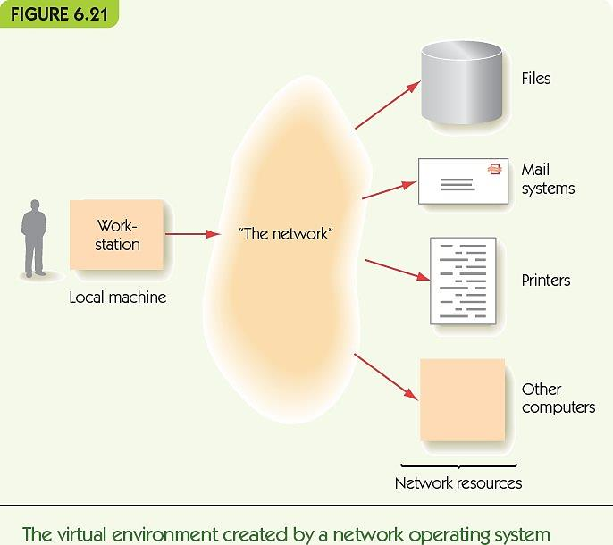
Operating Systems (18 of 21)

Slide 49
Operating Systems (19 of 21)
Fifth generation, the near future:
Multimedia interfaces (integrate images, speech, and video seamlessly)
Parallel processing system to perform multimedia and to permit larger scale tasks
Distributed computing environment in which users don’t know where resources are stored
Cloud computing

Slide 50
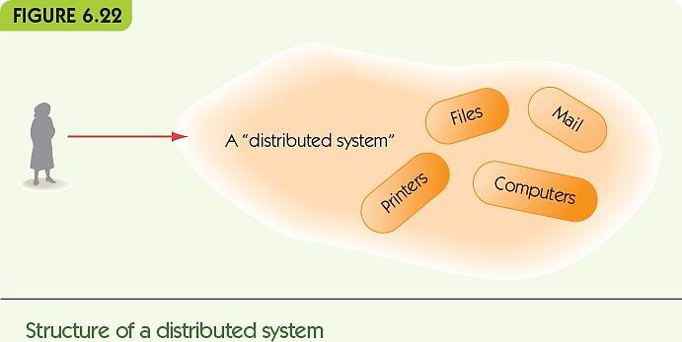
Operating Systems (20 of 21)

Slide 51
Operating Systems (21 of 21)
Some of the major advances in operating systems development
Generation | Approximate Dates | Major Advances
First | 1945-1955 | No operating system available Programmers operated the machine themselves
Second | 1955-1965 | Batch operating systems Improved system utilization Development of the first command language
Third | 1965-1985 | Multiprogrammed operating systems Time-sharing operating systems Increasing concern for protecting programs from damage by other programs Creation of privileged instructions and user instructions Interactive use of computers Increasing concern for security and access control First personal computer operating systems
Fourth | 1985-present | Network operating systems Client-server computing Remote access to resources Graphical user interfaces Real-time operating systems Embedded systems
Fifth | ?? | Multimedia user interfaces Massively parallel operating systems Distributed computing environments

Slide 52
Summary (1 of 2)
System software creates a virtual environment that is easy for users to use.
Assemblers and loaders are system software: translate human-friendly programs to machine language.
Assembly language uses symbolic names, symbolic op codes, and pseudo-ops to describe algorithms.
Assembler translates source programs to object files; loader places object instructions in memory.

Slide 53
Summary (2 of 2)
Operating systems communicate with users through text or GUI actions
The operating system includes key tasks such as the user interface, system security, scheduling of programs, and system safety
Operating systems developed through four generations of improvements, each adding new features and improving efficiency
Future operating systems: parallel, distributed, and multimedia, with resources stored remotely

